Slide 1

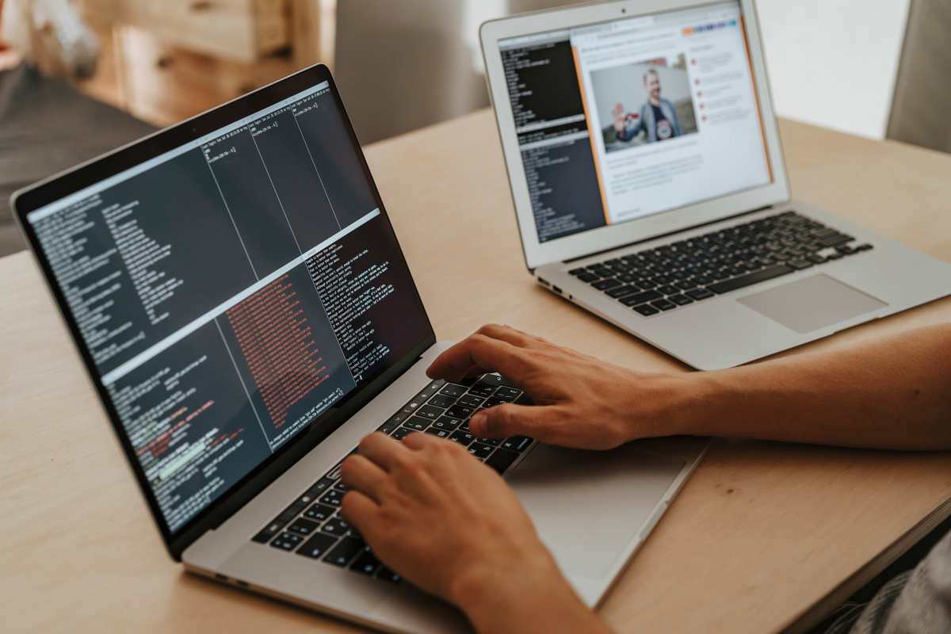
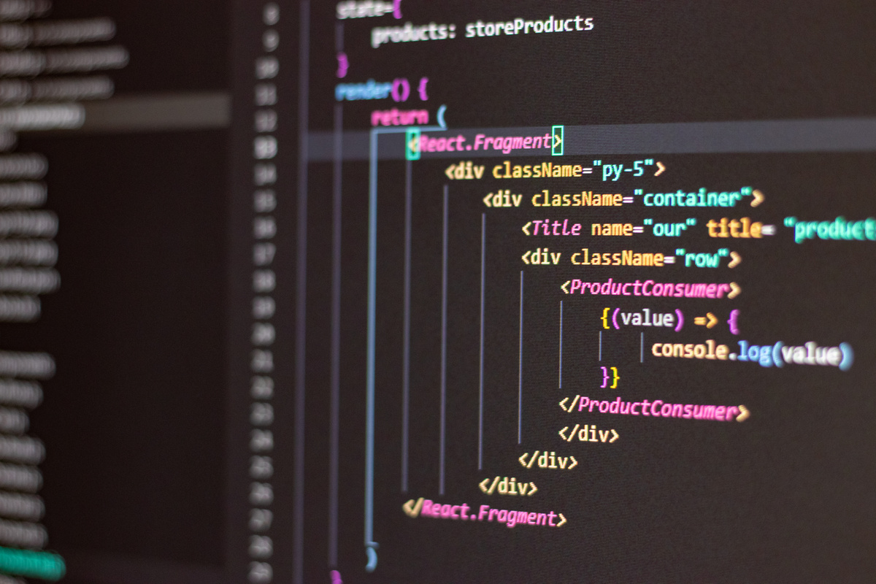
Programmer
Presentation
Presented By
Samira Hadid

Slide 2

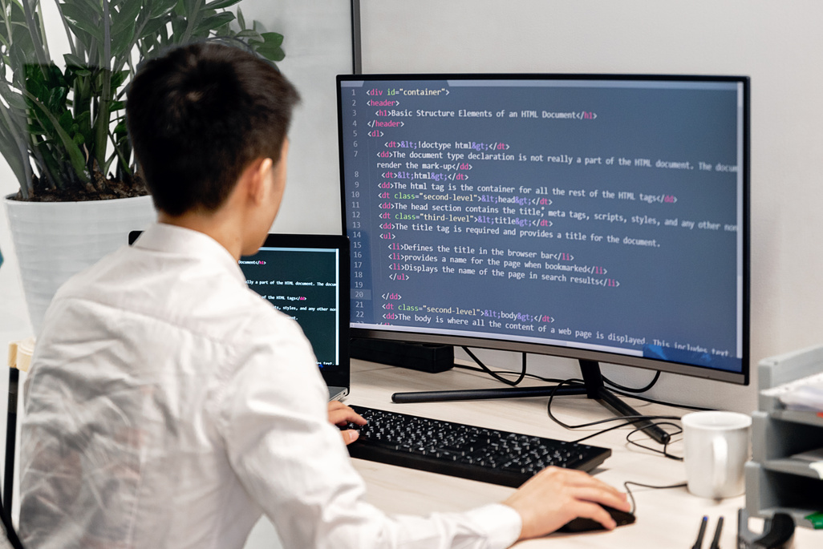
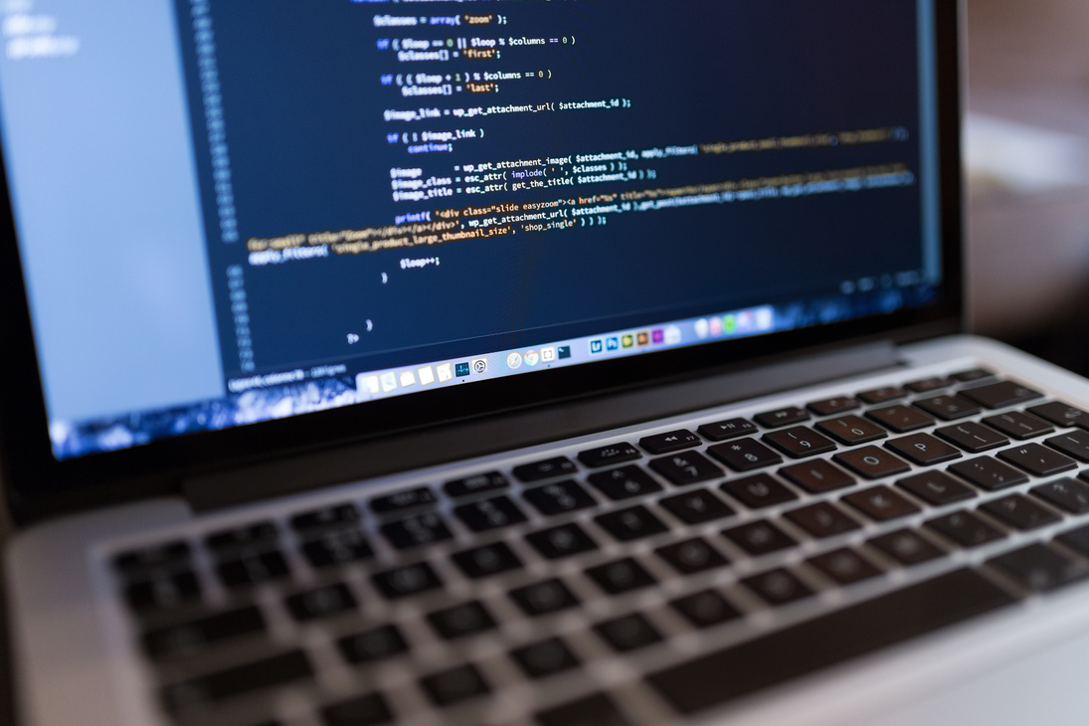
What is a Programmer
Imagine you have a friend who speaks only French, and you only speak English. You need a translator to help you understand each other, right?
A programmer is like a translator for computers! They write instructions (called code) in a language that computers understand, telling them what to do.

Slide 3
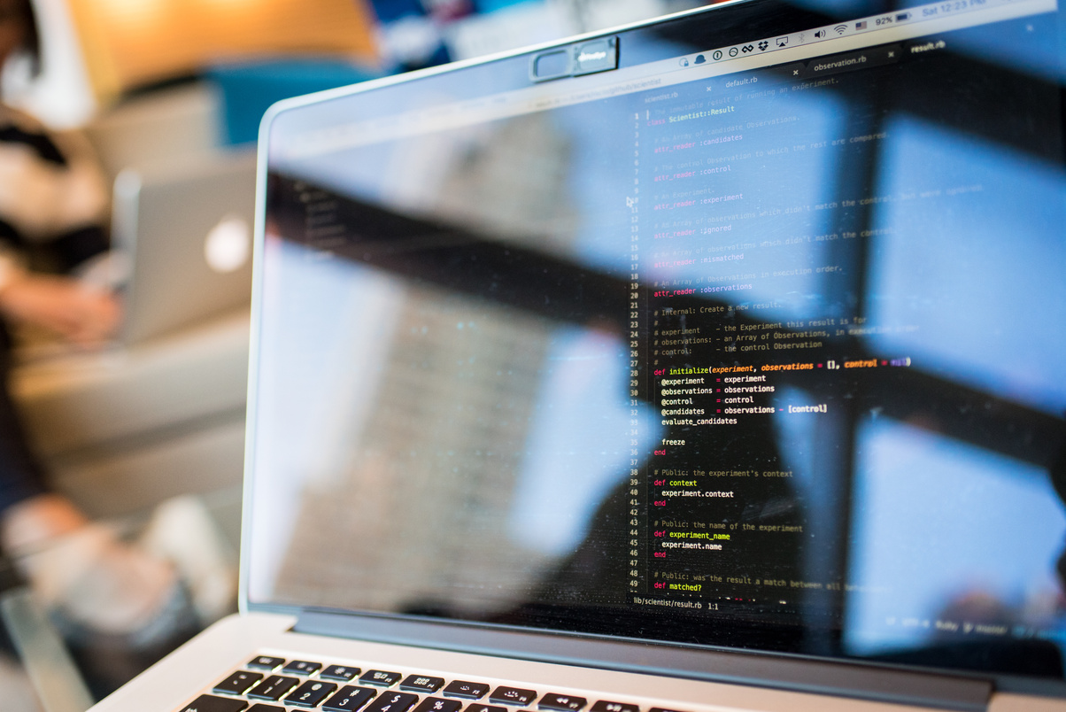
Just like there are many human languages, there are many programming languages! Python is used for lots of things, like websites and artificial intelligence - think of it like a helpful all-rounder.
Programming Languages
Java is often used for building apps on your phone. JavaScript makes websites interactive and fun. C++ is used for things that need to be super fast, like video games.

Slide 4
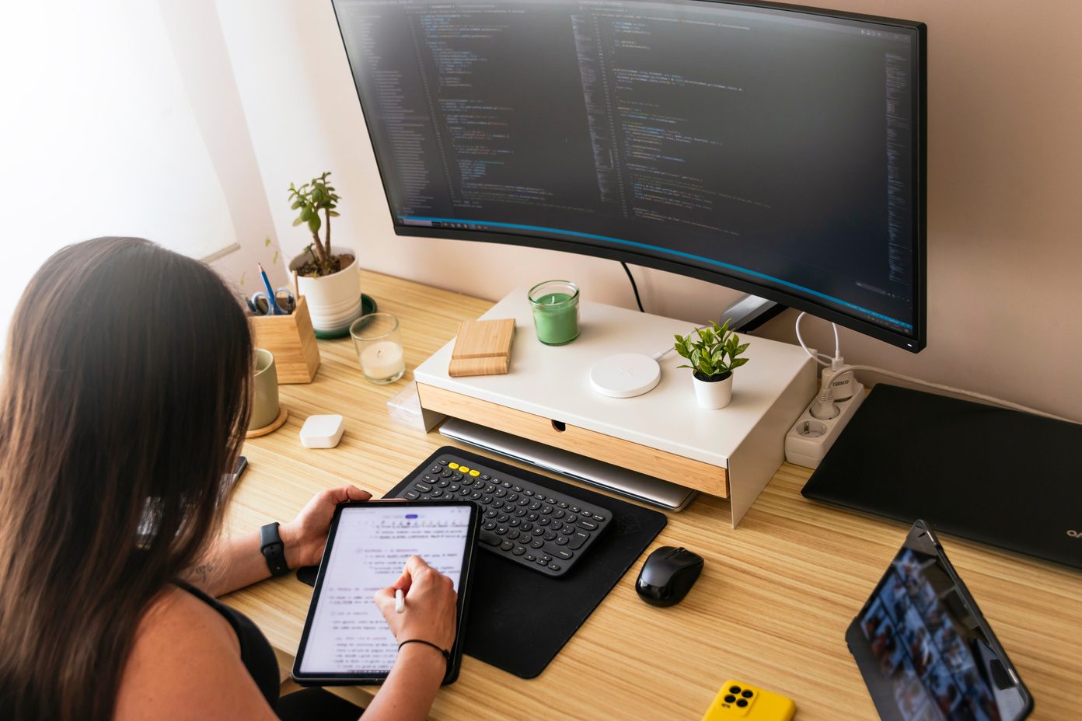
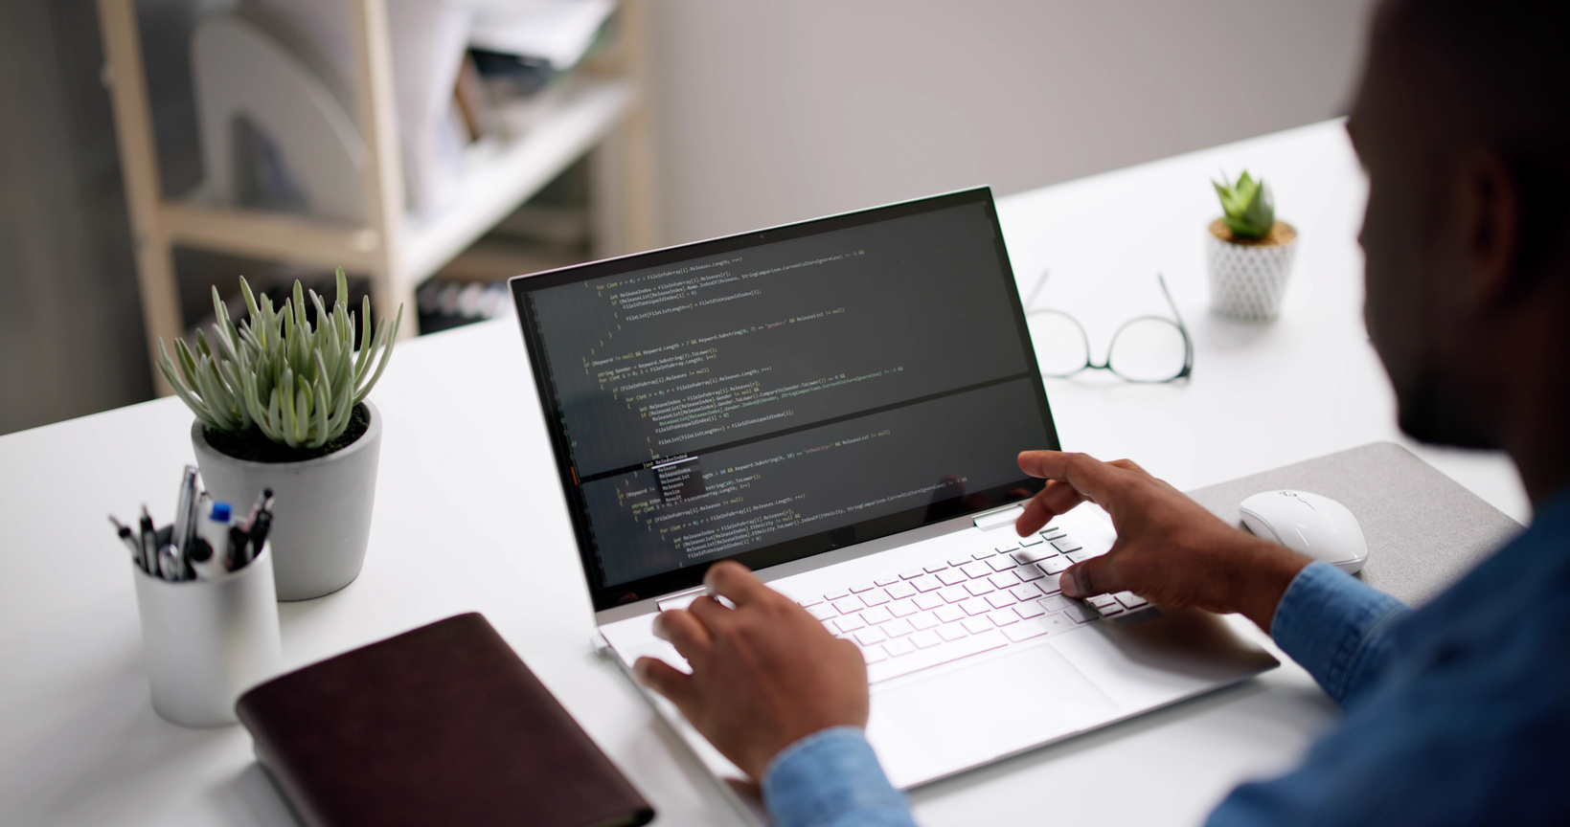
What do Programmers do?
Programmers do all sorts of things! They create the websites and apps you use to watch videos or chat with friends. They develop video games, from simple mobile games to complex adventures.
They even build robots and AI, teaching machines to think and learn. They can also analyze data, finding hidden patterns in information.

Slide 5
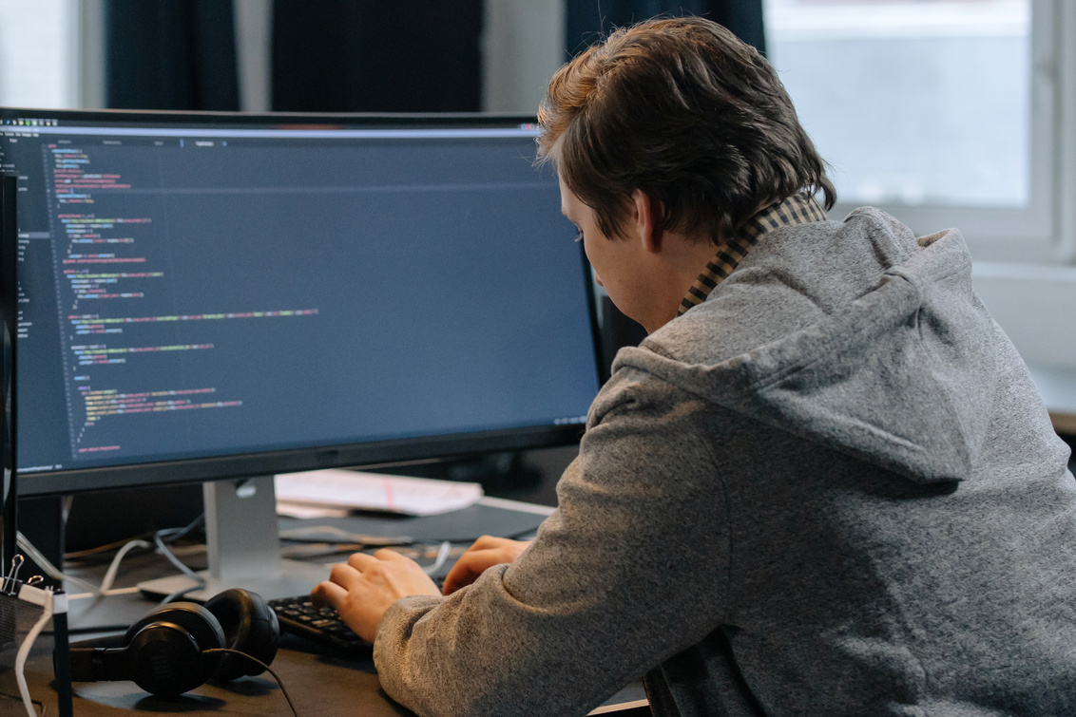
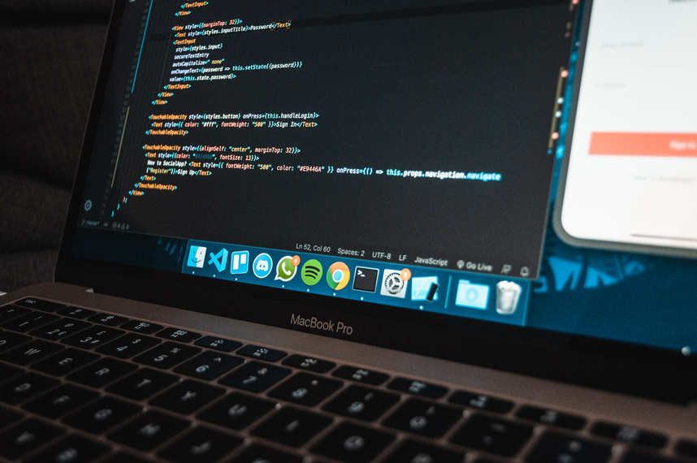
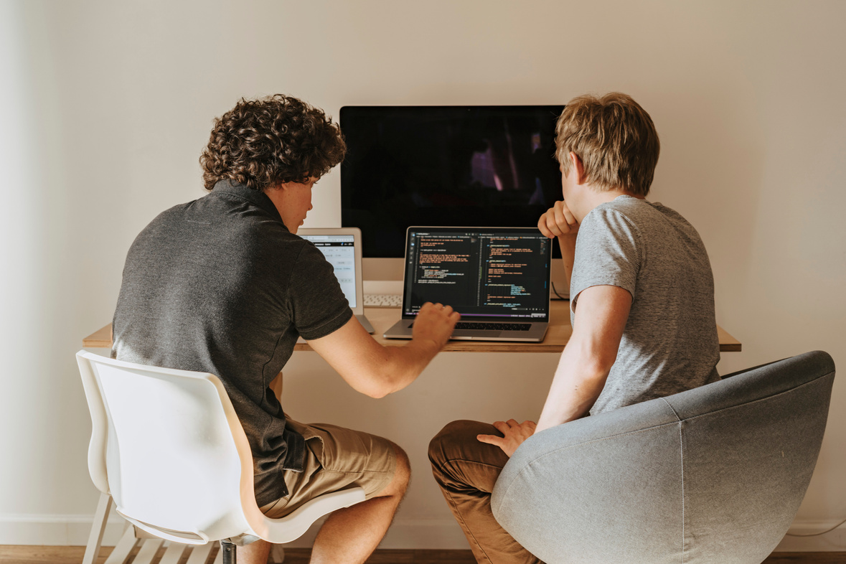
Building a Simple Game
Let's say you want to make a simple game where a cat chases a mouse. First, a programmer would design the game: how it looks, the rules, and so on. Next, they would write the code using a programming language to tell the computer how the cat and mouse should move, score points, and everything else that makes the game work.

Slide 6
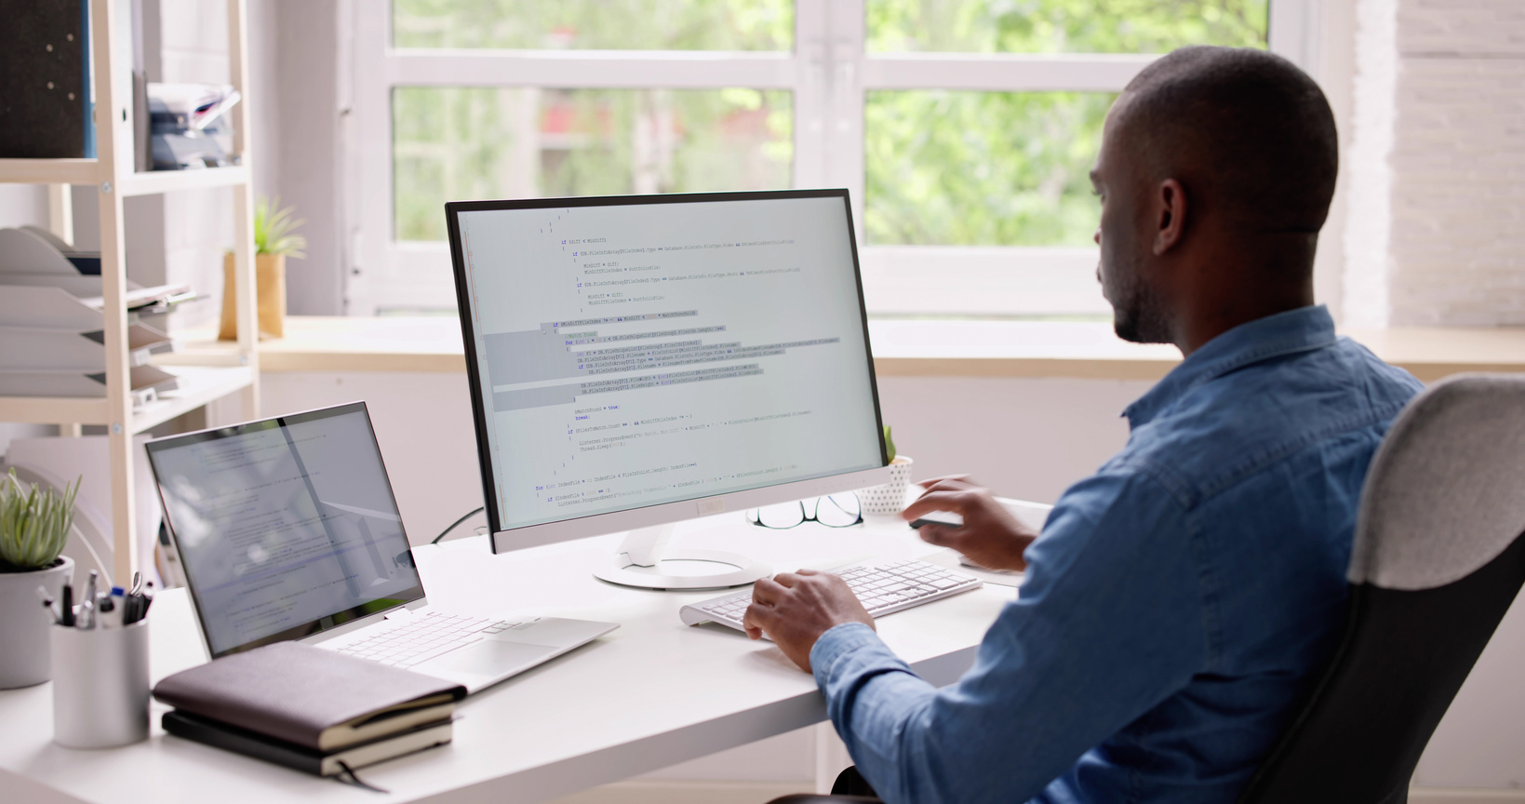
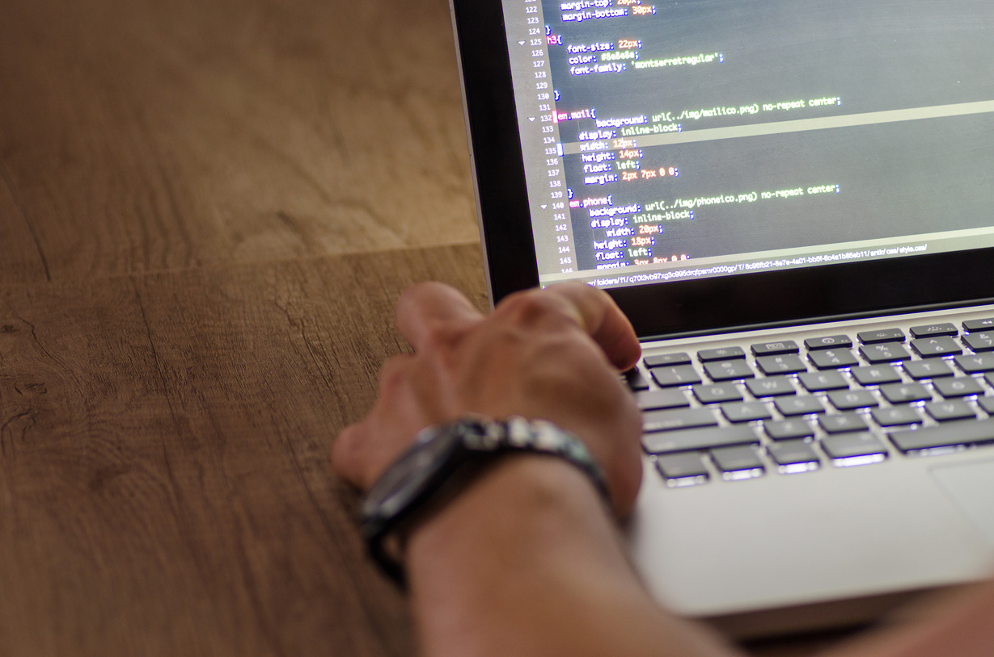
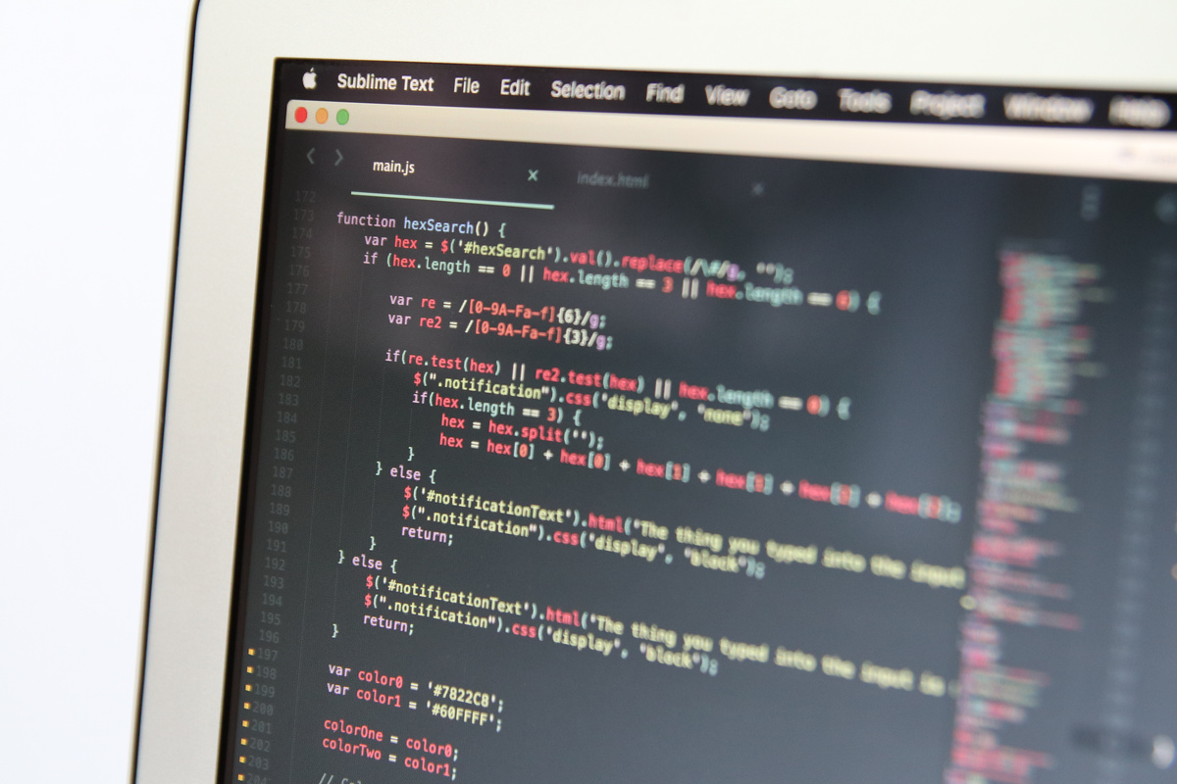
Oops! Bugs!
Everyone makes mistakes, even programmers! Sometimes there are errors in the code, called "bugs." Programmers need to find and fix these bugs to make their programs work properly. It's like being a detective!

Slide 7
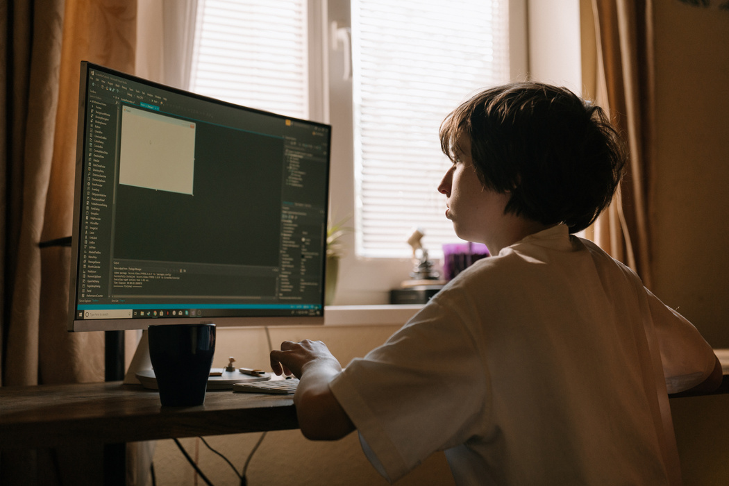
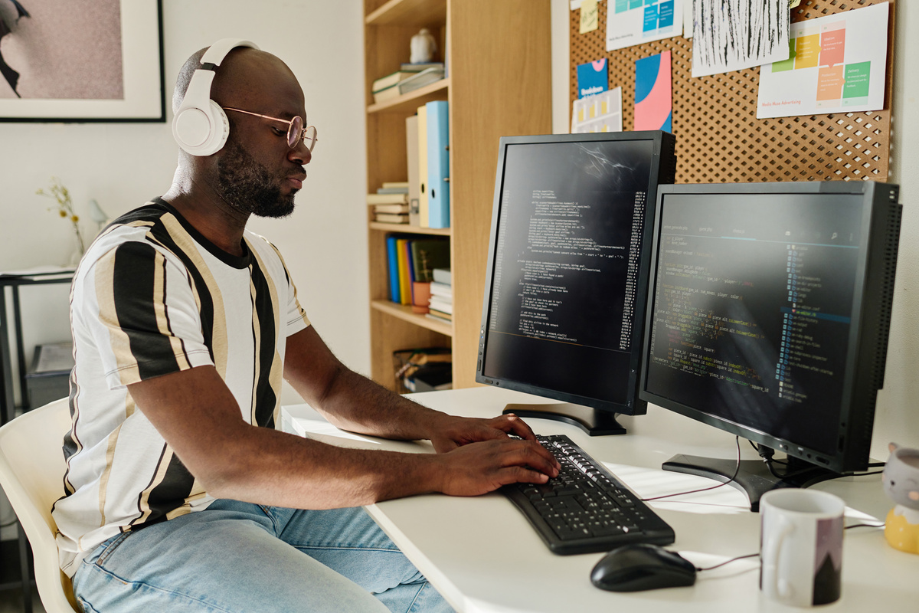
Programmers are Problem Solvers
Programming is all about solving problems. Programmers need to think creatively and logically to figure out how to make their programs do what they want.

Slide 8



Why is Programming Important?
Programming is important because it helps us create new technologies, making our lives easier and more fun. It helps us solve complex problems in areas like medicine, science, and engineering.

Slide 9

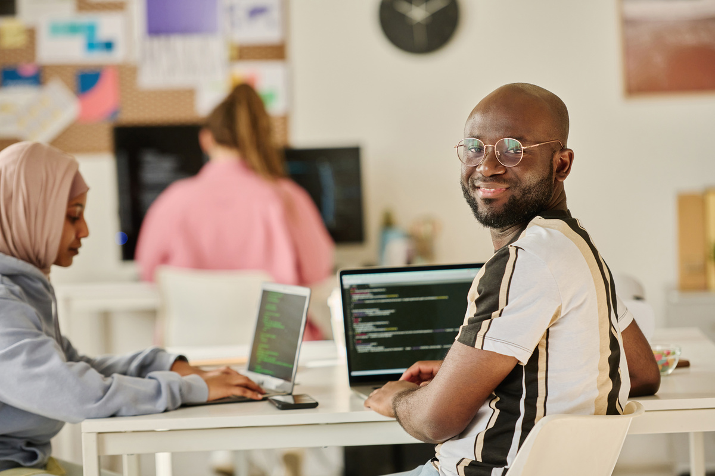
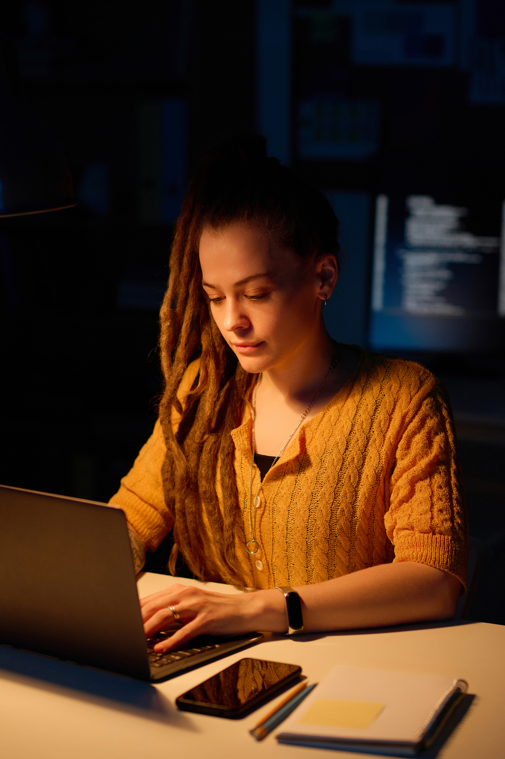
Want to Learn More?
The best way to learn is by doing! These websites have tutorials and games that can help you start learning about programming.

Slide 10
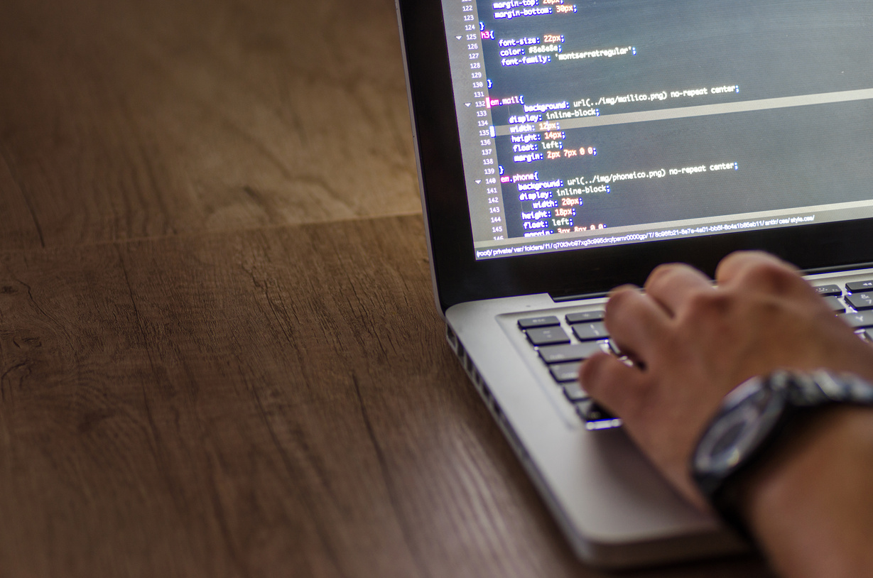
Thank You

